Slide 1
SQL JOIN
As the name shows, JOIN means to combine something. In case of SQL, JOIN means "to combine two or more tables".
The SQL JOIN clause takes records from two or more tables in a database and combines it together.
inner join,
left outer join,
right outer join,
full outer join, and
cross join.

Slide 2
Why SQL JOIN is used?
If you want to access more than one table through a select statement.
If you want to combine two or more table then SQL JOIN statement is used .it combines rows of that tables in one table and one can retrieve the information by a SELECT statement.
The joining of two or more tables is based on common field between them.
SQL INNER JOIN also known as simple join is the most common type of join.

Slide 3
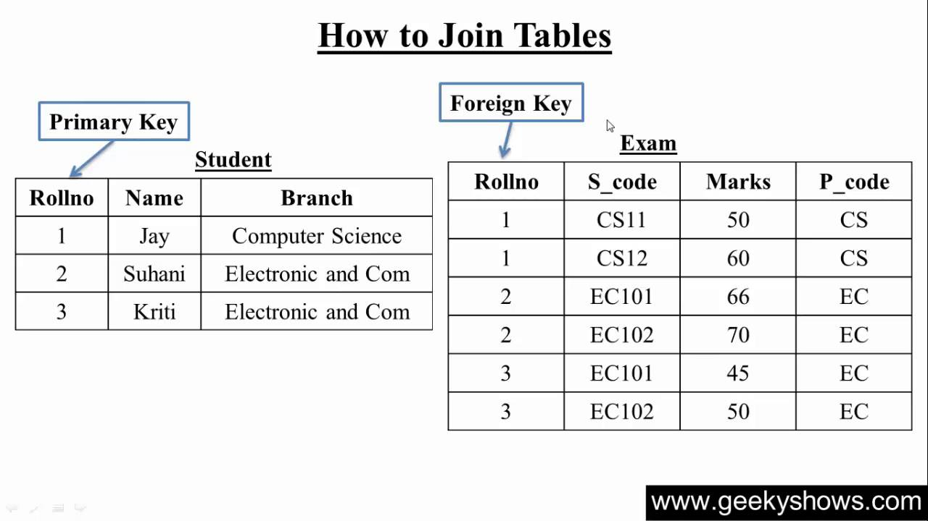
Table for joining

Slide 4
Inner join
SELECT Staff_ID, Staff_NAME, Staff_AGE, AMOUNT
FROM STAFF s, PAYMENT p
WHERE s.ID =p.STAFF_ID;

Slide 5
Outer join
SQL OUTER JOIN
In the SQL outer JOIN all the content of the both tables are integrated together either they are matched or not.
Outer join of two types:
1.Left outer join (also known as left join): this join returns all the rows from left table combine with the matching rows of the right table. If you get no matching in the right table it returns NULL values.
2.Right outer join (also known as right join): this join returns all the rows from right table are combined with the matching rows of left table .If you get no column matching in the left table .it returns null value.

Slide 6
SQL LEFT JOIN
The SQL left join returns all the values from the left table and it also includes matching values from right table, if there are no matching join value it returns NULL.
SELECT table1.column1, table2.column2....
FROM table1
LEFTJOIN table2
ON table1.column_field = table2.column_field;

Slide 7
SQL RIGHT JOIN
The SQL right join returns all the values from the rows of right table. It also includes the matched values from left table but if there is no matching in both tables, it returns NULL.
Basic syntax for right join:
SELECT table1.column1, table2.column2.....
FROM table1
RIGHT JOIN table2
ON table1.column_field = table2.column_field;
Eg-select name,s_code ,marks from student right outer join exam1 on student.rollno = exam1.rollno;

Slide 8
SQL FULL JOIN
What is SQL full outer join?
SQL full outer join is used to combine the result of both left and right outer join and returns all rows (don't care its matched or unmatched) from the both participating tables.
SELECT *
FROM table1
FULL OUTER JOIN table2
ON table1.column_name = table2.column_name;

Slide 9
SQL Cross Join
oin operation in SQL is used to combine multiple tables together into a single table.
If we use the cross join to combine two different tables, then we will get the Cartesian product of the sets of rows from the joined table. When each row of the first table is combined with each row from the second table, it is known as Cartesian join or cross join.
After performing the cross join operation, the total number of rows present in the final table will be equal to the product of the number of rows present in table 1 and the number of rows present in table 2.
For example: If there are two records in table 1 and three records in table 2, then after performing cross join operation, we will get six records in the final table.

Slide 10
SELECT TableName1.columnName1, TableName2.columnName2 FROM TableName1 CROSS JOIN TableName2 ON TableName1.ColumnName = TableName2.ColumnName;

Slide 11
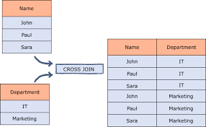
Tables for cross join

Slide 12
